Slide 1
L5 Accounting.
Team 7: Stanley, Duvall, Starlyn, zIaul, junior.

Slide 2
Add
Intro may be…

Slide 3
Add
Each team members rule may be…

Slide 4
Add
Other topics people presented may be…

Slide 5
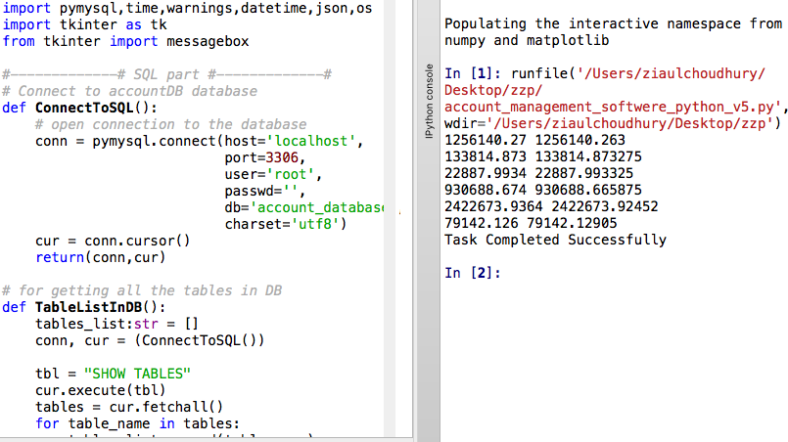
Backend Development (Python).
Screen-shot
Python Interactive IDE:
☻ Connects to the database.
☻ Reads client(s)’ data.
☻ Provides Graphical User Interface for the user inputs.
☻ Adds new data to database from the input.
☻ Generates HTML reports (recent, monthly, quarterly tax, all, and summary).

Slide 6
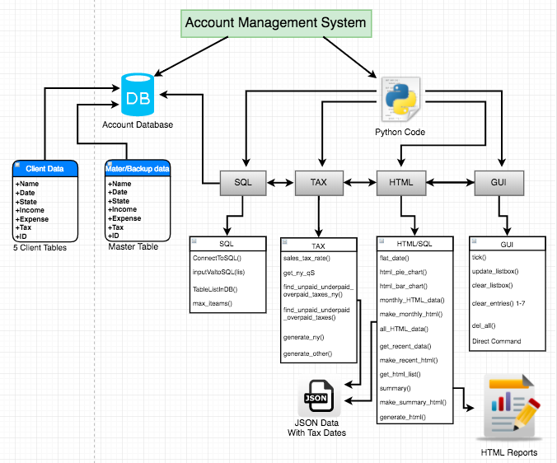
UML Model for the Application.

Slide 7
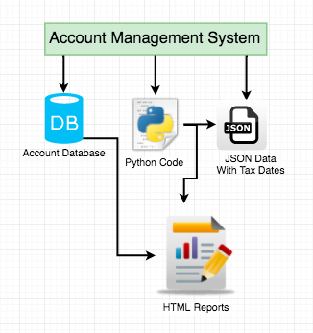
Simple UML and Some Pros.
Simple UML
Pros
Dynamic (able to add new client).
Robustness (valid input for some parts).
Reusability (objects and classes can be reused).
Portability( can run on Windows or MAC OS).
Data encapsulation (data is hidden to the other individual users except for the admin).

Slide 8
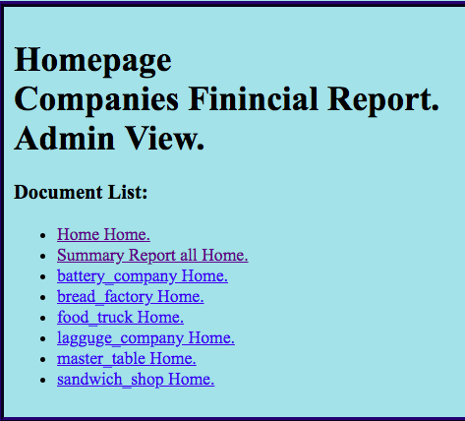
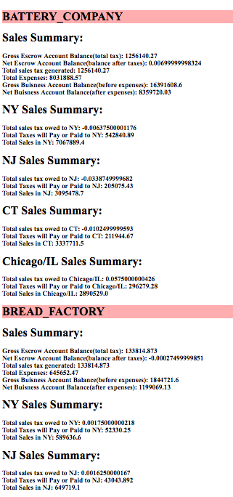
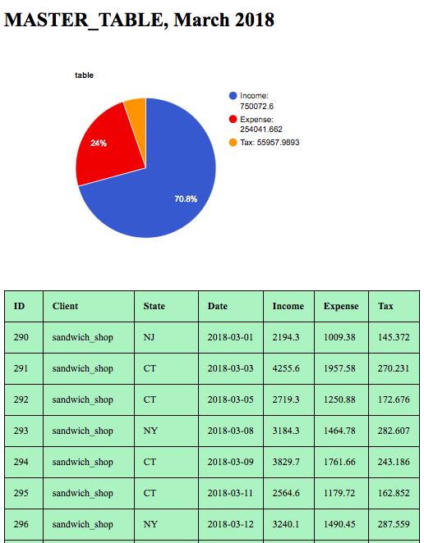
Homepage & Reports.
Admin Homepage
Summary
Monthly Report

Slide 9
Add

Slide 10
Add

Slide 11
Add more pages if needed

